Slide 1
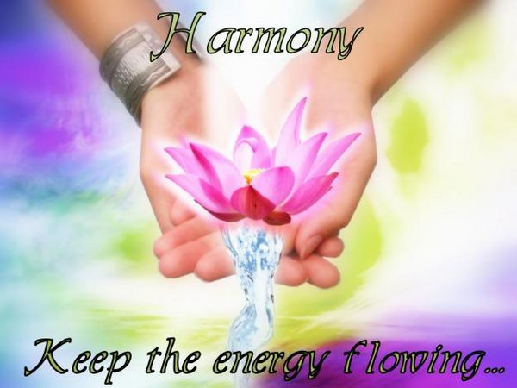
Aligning Your Energy Body to Your Humane Body
Do you want…..
Life Long Vitality ?

Slide 2
Physical Body

Slide 3
What is the human body?
It is an amazing structure of systems organized biologically.
By the time the human reaches adulthood, the body consists of close to 100 trillion cells, which is considered the basic unit of life.
Each cell has a nucleus which houses the atoms which are made up of protons, electrons and neutrons.
Atoms are formed when the neutral force combines with the positive and negative aspects of the Sound
Notes:
Reference Beyond the light by Ginny Katz pg 15

Slide 4
Four Qualities of Sound
Substance-protons, neutrons and electrons are first given this out of the Sound
Character-compels them to define their own unique qualities and quantities relative to each other
Rhythm-gives them orderly movement and life, this order is made possible by magnetism
Magnetism-draws atoms into organized molecules, cells, and eventually complex organism which make up the human body

Slide 5
Energy Body…

Slide 6
What is the energy body?
It is commonly treated as if it has different shapes… an amorphous constantly changing cloud, elliptical or an egg shape, yet it can also be treated as an exact duplicate of the physical body.
This is sometimes difficult for closed minded people to understand.

Slide 7
Amorphous Constantly Changing Cloud

Slide 8
Elliptical Shape

Slide 9
Egg Shape

Slide 10
Physical Body beside Energy Body

Slide 11
Alignment and Completely Healthy
When the physical body and the energy body are centered on and aligned with each other they will make the exact same movements in the exact same way to achieve some goal. When these two bodies are working towards the same goal the physical body will then be at its healthiest, its strongest and its most efficient.

Slide 12
Misalignment and Health Problems
If the energy body is not aligned with the physical body the strength of the physical body would be negatively affected because the assistance that the energy body gives would not be there. It also works with the same way with the organs

Slide 13
How do we find out the current relationship between these two bodies?

Slide 14
Steering Wheel Test
The energy body is what tries to accomplish the goal as shown either the energy body drags the physical body along or the physical body follows trying to keep up with the energy body
Sit behind a steering wheel in a comfortable and natural way
Then have someone look at the position of the body to the steering wheel

Slide 15
The Roles of the Energy Body
When you sit behind a steering wheel it is the energy body that would align itself on the steering wheel
This would show the relations of the physical body normally to the energy body
The physical body will either be centered, left or right of the steering wheel

Slide 16
How to correct this misalignment
Asian Kung Fu
Pilates
Dancing/Exercising*
Sound Healing
Reiki
Chakra Balancing*
Well Being Alignment Sessions
*Discussed in this presentation

Slide 17
Dance/Movement/Kundalini Yoga
Please view the following video of Kundalini Awakening (28.01)
http://video.google.com/videoplay?docid=-8101989694941061600&hl=en#
Feel free to connect your lap top to your TV or put it full screen on your monitor so that you can do some full body free movement to the wonderful music that accompanies the narrative in the video. Always remember all you have to do is have FUN ☺ GOOD FOR YOU!!!!!

Slide 18
Balancing Root Chakra

Slide 19
The Muladhara
1st chakra - Base, Root Chakra
Color – Represented by Red and Black- As a general rule, red stones offer protection, courage, vitality, stamina, and energy
Located at the Base of the spine-This is our Grounding and Survival Chakra
It is aligned with the planets Pluto and Mars
Red is powerfully linked to our most primitive physical and emotional needs of survival and self preservation and it symbolizes energy, action, confidence, courage, and change. It also brings passion and strength to your relationships, your life and your work
When this Chakra is blocked we experience: Lack of energy and vitality, depression, anxiety , fear, anger and frustration. It is encouraged to put doTerra’s Rosemary CPTG Essential Oil* on the bottom of your feet www.mydoterra.com/youngspirityoga
Additional information http://www.sobrietystones.com/resources/Colors/meaning_color_red_1.htm
*dilute with fractionated coconut oil for children and sensitive skin

Slide 20
Muladhara Meditation
When this chakra is balanced you will feel stable, safe and secure.
Rub the suggested doTerra oils on the bottom of your feet
Place a red gemstone in your hand and when the music starts hold it over the root chakra(ruby or Carnelian)
Then connect to this music link http://www.youtube.com/watch?v=vAu9WYP5voY and follow the below guided meditation
Take a few moments to close the eyes and relax the mind as you prepare for meditation.
Focus on your root chakra, located at the base of your tailbone.
Count 10 slow deep breaths as you continue to focus on grounding your energy down through your tailbone area.
Imagine a glowing red light, with each inhale feel the red light fill your body and with each exhale release any sensation of tension or tightness.
Continue to focus on the breath and the flow of energy in and out of the body.
Next feel the energy of the red light move down from the root center to the hips, legs and feet. Notice the sensations of warmth and ease in the lower body.
Stay here with a calm breath for 5 minutes or longer.

Slide 21
Thank You

